Slide 1
Session 1 – Reproducibility Principles Data Skills for Research Kellogg Research Support
August 14, 2023
Notes:
Welcome. We are so happy you’re here.
What you are about to hear next is about the closest you will get to a lecture in this workshop series. Most of the rest of this will be pretty interactive.
There will be discussions and you follow along with a demonstration, and maybe try to solve a few problems yourself.
But before we get into demonstrations of tools and how to apply them to your research work, I want to talk a bit about the reproducibility of that work you are about to start.
It is a very important topic, and I believe there are a few general principles that, if kept in mind, can help you quite a lot when you go to reproduce your work in the future.

Slide 2
Previous Experience
What programming languages do you use?
What do you find difficult about replicating others' work?
Notes:
Tell me about some things you do to prepare your data for analysis/clean your data.
Do you program? Know about KLC?
Work with survey data? Observational data?

Slide 3
PART I – Replicability

Slide 4
Who Cares About Replicating Results?
Co-authors and RAs
Referees of your paper
Readers of your paper
Journal editors, increasingly
Maybe most importantly to you, your future self!
Notes:
You should care about reproducibility because it matters to so many different people.
<CLICK>
When you publish your work, you will need many other stakeholders to be able to reproduce your results. It will be a problem for you when they cannot.
<CLICK>
Speaking of headaches, your collaborators will thank you – or curse you – depending on how easy or difficult it is to follow what you have done and replicate results consistently.
Even if you do not expect to work with others or do not value their feelings, there is one very important collaborator you will always have:
<CLICK>
Your future self. That person will always be responsible for everything your younger self does. Be kind to the future version of you.

Slide 5
Why Are Papers So Hard To Replicate?
Reproduction is difficult for the same reason collaboration can be difficult.
You and will need to…
… deploy multiple versions of your survey
… collect multiple waves of survey data and merge them correctly
… take steps to "clean" the raw data
… try out multiple regression specifications
… re-run models using different inclusion criteria
… transfer the results correctly into your paper
Or someone might…
... accidentally overwrite a file
... intentionally overwrite a file
... quit and take their procedural knowledge with them
… rely on software that your future self will not have
Notes:
There are many ways your quantitative research could become difficult to reproduce.
<CLICK>
For one thing, you will probably try many different model specifications, sampling schemes, and data cleaning techniques as you create different drafts of your paper.
You need some way to keep the versions of your data, your code, and your paper in sync.
<CLICK>
You might also have a very long time interval between when you do your work here and when your manuscript is published. A few years or even longer.
What if you can’t rerun your code on the computer it was on? Or if some of the software functions you called have been deprecated?
<CLICK>
What about all the files you used? Have they been backed up? Are you sure the files in your backups are exactly the same as the ones you originally used?
<CLICK>
Or does some aspect of your work rely on a collaborator to do something that you don’t know how to repeat for yourself in the future?

Slide 6

Will You Collaborate Well With Yourself?
10 years from now, will you be able to recreate every result from the paper you are currently writing?
- or a paper where you and a coauthor split the work?
- or a paper that goes through multiple rounds of R&R?
When you submit a paper to a journal, will you be ready to share your data?
- and working code that will verify your results?
- and documentation that is unambiguous to someone else?
Will you be prepared to replicate you own work after you leave Northwestern?
Notes:
Just ponder these situations…
What would it take for you to reproduce some non-trivial piece of work you did 4 years ago?
Well, I bet it will take something similar for your future self to be able to reproduce your work today, 4 years from now.
One day, you will all move on from Northwestern. That should get you thinking: What will I need to do with all my files and notes when I go somewhere else?

Slide 7
3 Simple Principles for Replication
1. Automate Whenever Possible
2. Keep Good Records
3. Test, Test, Test!
Notes:
Fortunately for you, this is a management, and we have some commonsense ideas for how to make collaborations – including with your future self – work better.
Some of those concepts that are most relevant to your scientific computing projects include:
Keeping records of what you do that will be easy to use,
Being very economical with your solutions. The #1 easiest way to fail at replicating your results is to present yourself with 2 different ways to solve the same problem.
And recognize that humans make mistakes. We forget things. We sometimes make poor decisions. So more generally, give your future self fewer opportunities to make mistakes.

Slide 8
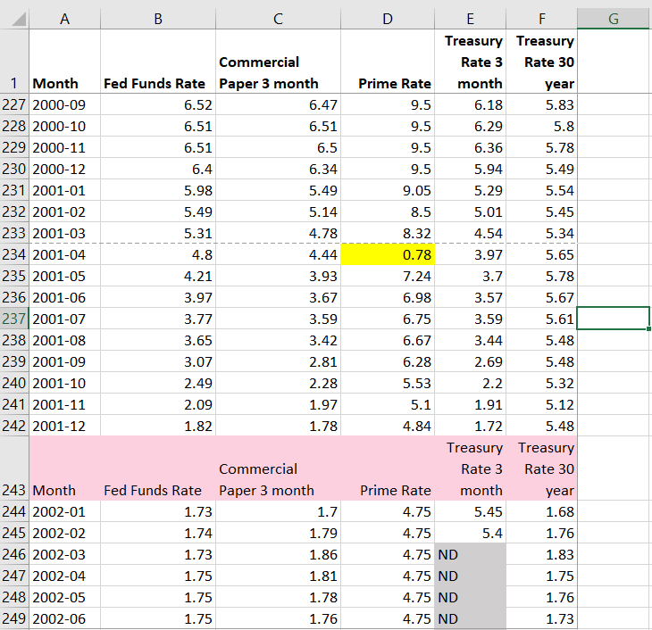
Automation Opportunities
You need to fix this flawed source data:
* Delete extra
* Move the decimal place in one cell
* Set ND to missing values
header rows
Why not just fix these issues in Excel?
Notes:
Here is one last cautionary example about manual work.
This is real source file with historical information about different interest rates, and it is a messy file.
Highlighted in yellow is a cell that contains a clerical error. The prime rate in April, 2001, should be 7.8 -- not 0.78
The file also has some inconvenient flaws. The header row keeps repeating throughout the data, what you see highlighted in pink.
Also, the source file uses “ND” to indicate null. You probably would want those values in the CSV file to be blank before reading these into Stata.
<CLICK>
So the dilemma is, you could fix these issues in a few seconds in Excel.
Just overwrite cell D234. Manually delete the extra headers. Do a global search and replace on “ND.”
But should you?
If your future self had to recreate your analysis from scratch in the year 2025, would you remember to do all those things exactly as you had before?

Slide 9
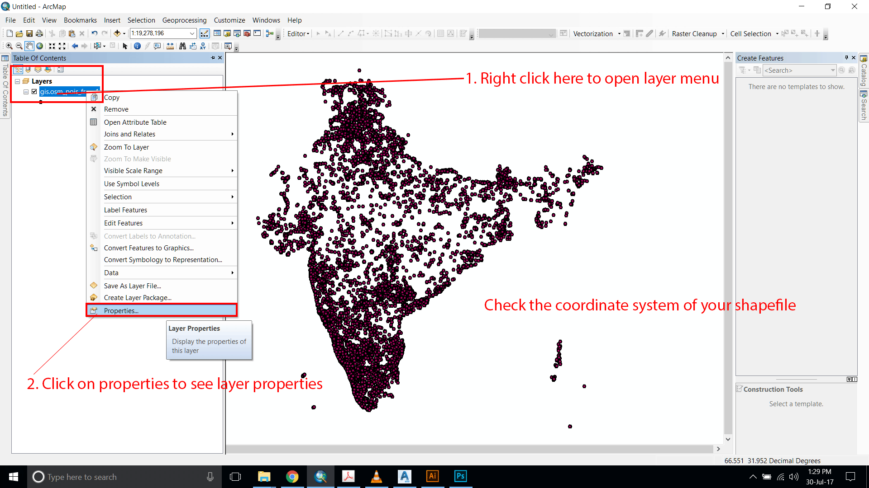
Automation Opportunities
Will you or your colleague be able to do this years from now?
Notes:
Along the same lines, you want to be mindful of work you are doing by clicking your mouse.
Again, this is something we all do. In fact, what you see in front of you came from an actual ArcGIS tutorial we helped to organize a few years ago.
Some tools, like ArcGIS, certainly make it easy for you to perform complex actions with a sequence of intuitive mouse clicks.
But should you?
If you had to recreate this geospatial project from scratch 4 years from now, would you possibly forget the exact sequence of menu clicks you did?
Or maybe, the menus might be very different in a future version of the software?
If there were a way to script these actions – and leave a record behind of what actions were taken – that seems much kinder to your future self.

Slide 10
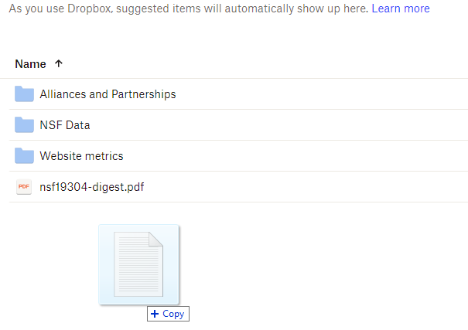
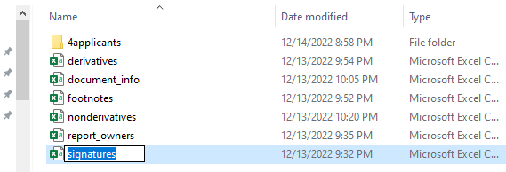
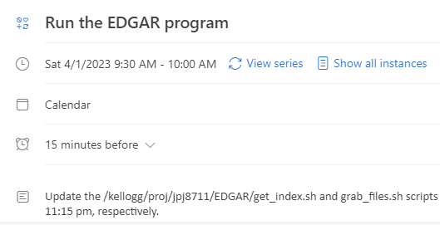
Automation Opportunities For You?
Notes:
Along the same lines, you want to be mindful of work you are doing by clicking your mouse.
Again, this is something we all do. In fact, what you see in front of you came from an actual ArcGIS tutorial we helped to organize a few years ago.
Some tools, like ArcGIS, certainly make it easy for you to perform complex actions with a sequence of intuitive mouse clicks.
But should you?
If you had to recreate this geospatial project from scratch 4 years from now, would you possibly forget the exact sequence of menu clicks you did?
Or maybe, the menus might be very different in a future version of the software?
If there were a way to script these actions – and leave a record behind of what actions were taken – that seems much kinder to your future self.

Slide 11
Good Records: Organize Directories
This was a real directory with code & data that Research Support used to monitor traffic load on the Kellogg Linux Cluster.
If you wanted to use this data, is it clear where to look?
active_netids.txt
active_usernames.txt
daily_email.sh
email_lookup.py
emails_of_active_users.sh
loadavg.gnuplot
loadavg_history.klc01.txt
loadavg_history.klc02.txt
loadavg_history.klc03.txt
loadavg_history.klc04.txt
loadavg_history.klc05.txt
loadavg.png
monitor_load.sh
netids_of_active_users.sh
renice/
users_history.klc01.txt
users_history.klc02.txt
users_history.klc03.txt
users_history.klc04.txt
users_history.klc05.txt
vmstat.gnuplot
vmstat_history.klc01.txt
vmstat_history.klc02.txt
vmstat_history.klc03.txt
vmstat_history.klc04.txt
vmstat_history.klc05.txt
vmstat.png
Notes:
Tell me, does this situation sound familiar to you? Let’s say you go to a directory containing a project that one of your colleagues spent a lot of time on.
You just want to find one piece of information, but what you see is confusing to you, and you spend a lot of time opening random files and hoping to get lucky.
This is an actual directory created by Research Support for a project to monitor and report the usage load on KLC.
Where would you go to find the data showing load by user last week?
<Opportunity for interaction… one of these “history” files?>
The answer is surprising to me. It is actually underneath the “renice” subdirectory.

Slide 12
Good Records: Organize Directories
Suggestion: Use intuitive directory structures and file naming conventions.
monitoring/
README.txt
inputs/
outputs/
programs/
run_logs/
versions_old/
programs/
1_get_ps.py
2a_sum_users.py
2b_sum_load.py
3_make_graphs.py
4_send_email.py
RUN_ALL_PROGRAMS.sh
Notes:
Ah, but suppose when you go inside that “renice” directory, you see something like this!
There is a readme file to explain what you need to know, but I can infer a lot without reading it.
You have subdirectories that clearly separate inputs, outputs, and the programs that create those outputs. It looks like there is a place containing logs of every time the jobs have run.
And those programs are named in a “self documenting” way. I think I know what order the jobs need to be run in, and there appears to be a script that will run the whole sequence for me.

Slide 13
Good Records: Document Your Code
Document Everything!
Suggestion: Only document what you are willing to maintain constantly.
Notes:
This should be obvious to everyone. You should always document your code, and more comments and read-me files is bound to make things easier for your future self. Right?
<pause for effect>
<CLICK>
Actually, NO! I maintain that less is more when it comes to documentation.
In any event, you ABSOLUTELY MUST maintain your documentation. So if you have got comments running throughout your code, that’s fine,
but you will need to update the comments each time you update the code. Otherwise, you run the risk of your code doing one thing and your comments saying another.
That is a sure fire recipe for confusion when you crack open your Python program for the first time in 24 months to figure out why the numbers are suddenly different.

Slide 14
Good Records Don’t Repeat
Abstraction
Build your programs from modular code blocks
(a.k.a. functions, procedures, macros, subroutines, etc.)
Produce consistent, repeatable results across programs
Only one place needs documentation
Only one place needs testing, debugging
Notes:
This “Don’t Repeat Yourself” principle has to do with that second issue: You are better off solving a programming problem once rather than twice.
This is most easily achieved by designing and writing your code to use and reuse modular pieces.
Depending on your programming language, these modular pieces might be called functions, procedures, macros, and so forth.
That might be intimidating to someone who is new to programming, but the concept is very simple:
If you ever find yourself writing the some chunk of program in two different places to do the same thing… stop, and find a way so you can just write it once and then call it twice.
If you write the same block of code in two places, you open up the chance for the two blocks to get out of sync with each other.
You will see these ideas in action in later weeks as we work with text and discuss data validation.

Slide 15
One Way People Repeat Themselves
use "/rawdata/2018/wages.dta, clear
keep if taxyear == 2018
generate lnwage = ln(wage)
Scatter lnwage tenure, title("ln(wages) versus Tenure, 2018")
regress lnwage educ gender tenure
regsave educ gender tenure using results,
table(OLS_stderr, order(regvars r2))
replace
use results, clear
outsheet using results_2018.txt, replace
Notes:
One last idea…
To reproduce results implies that you were able to produce them correctly in the first place.
So throughout the workshops, we will try to emphasize the virtue of breaking your problems into smaller pieces
And then testing them relentlessly to convince yourself they are doing what you expect them to do.
Near the end of the series, one of our hours will be dedicated to helping you make your code “bulletproof.”

Slide 16
Good Records: Version Control
Your Programs
Manage versions of your code with tools like git
Open Source Packages
Tools like conda
Computing Environments
Tools like Docker and Singularity (for preserving a KLC/Quest environment)
Notes:
Throughout these workshops, we will expose you to tools that will help you maintain a version history of your assets.
You will get a healthy dose of github over the next 7 weeks. I am sure many of you have used it to download source code from others.
Some of you may have even shared some of your own work with the world this way.
We want you all to have practice using several aspects of Github, pulling from a repo, committing your changes back to it, and reverting to a prior version.
<CLICK>
In addition, you will be exposed to some other powerful version control tools.
Most notably, you will see a few instances of conda, which you can use to create a version history of your Python packages.
This will help address the challenge I mentioned earlier, of using software that may or may behave the same 4 years from now. (If it is still available then.)

Slide 17
Testing
What you replicate must also be correct!
Suggestion: Assume your work has errors; take joy from finding them.
Make a list of testable propositions
Even things that shouldn't ever go wrong, could go wrong
Be imaginative
Notes:
One last idea…
To reproduce results implies that you were able to produce them correctly in the first place.
So throughout the workshops, we will try to emphasize the virtue of breaking your problems into smaller pieces
And then testing them relentlessly to convince yourself they are doing what you expect them to do.
Near the end of the series, one of our hours will be dedicated to helping you make your code “bulletproof.”

Slide 18
Summary
Incorporate programming into your work for efficiency and self-documentation.
Design your work as a series of modular tasks.
download data
examine contents
filter observations
make new fields
merge w/ existing data
calculate results
write results to paper
repeat last two steps
log your activities
update documents
notify collaborators
Test each modular step in isolation.
Notes:
One last idea…
To reproduce results implies that you were able to produce them correctly in the first place.
So throughout the workshops, we will try to emphasize the virtue of breaking your problems into smaller pieces
And then testing them relentlessly to convince yourself they are doing what you expect them to do.
Near the end of the series, one of our hours will be dedicated to helping you make your code “bulletproof.”

Slide 19
What to Expect this Week
Fundamentals
Abstraction – Write and test modular code
Automation – Script and test workflows with little intervention
Applications
WRDS
Demand Estimation Models
Qualtrics
High Dimensional Models
Lots of practice using KLC in batch mode, GitHub, conda
Notes:
Tell me about some things you do to prepare your data for analysis/clean your data.
Do you program? Know about KLC?
Work with survey data? Observational data?

Slide 20
Break

Slide 21
Appendix – Text Editors on KLC
KLC has several text editors available for you to use. The links below provide the basic syntax for other text editors available to you:
Nano: From any terminal session on KLC, type:
nano <file_name>
https://www.redhat.com/sysadmin/getting-started-nano
Emacs: From any terminal session on KLC, type:
emacs <file_name>
https://www.redhat.com/sysadmin/beginners-guide-emacs
Vi: From any terminal session on KLC, type:
vi <file_name>
https://www.redhat.com/sysadmin/introduction-vi-editor
Notes:
One last idea…
To reproduce results implies that you were able to produce them correctly in the first place.
So throughout the workshops, we will try to emphasize the virtue of breaking your problems into smaller pieces
And then testing them relentlessly to convince yourself they are doing what you expect them to do.
Near the end of the series, one of our hours will be dedicated to helping you make your code “bulletproof.”

Slide 22
Common KLC Tasks
Kellogg Computing
Software Modules
Open connections and start sessions
Transfer files to and from KLC
Open a terminal and use the shell
Use graphical tools for R, Stata, Python
Command line tools for R, Stata, Python
Clone and use Git repos
Create Conda environments (next workshop)
Notes:
Actions to Demonstrate and Explain
Log into KLC using FastX in browser
Navigate directories with cd and ls
Where to store which files?
Make a directory with git clone
Load module
Note software version
Open a file with nano, inspect contents, make a minor change (like update a parameter)
Open a program file using a GUI
R program in rstudio
Stata .do file in xstata-se
Python in a Jupyter notebook
When to use GUI versus headless batch process
Repeat R, Stata programs from command line
Inspect output
Save changes and commit back to GitHub repo

